Slide 1

WIPRO NGA Program – 25SUB4530_CP_JAVA
Capstone Project Presentation – 9th Feb & 10th Feb 2026
Project Title Here – Banking Management System
Presented by – Ambati SaiNithin, Amitkumar Surendranath Gouda – Team 1
www.rpsconsulting.in

Slide 2

Banking Management System
Introduction :
The Banking Account Management System is a web-based application developed to manage basic banking activities in a digital and efficient manner.
The system helps in maintaining customer account details, handling transactions, and storing banking data securely.
By using this application, banks can reduce manual work and improve the accuracy of their operations.
It provides a user-friendly interface that allows users to access banking services easily and quickly.
2024 - RPS Consulting all rights reserved

Slide 3
Banking Management System
Problem Statement :
Traditional banking systems depend heavily on manual processes and paperwork, which often result in errors, delays, and difficulties in maintaining records.
Managing large volumes of customer data becomes complex and inefficient. Customers also face problems in tracking their account details and transaction history.
Therefore, there is a need for an automated and centralized banking system that ensures accuracy, security, and faster operations.
2024 - RPS Consulting all rights reserved

Slide 4
Banking Management System
Objectives:
The key objectives of the Banking Management System are:
To develop a secure and user-friendly banking system
To automate basic banking operations
To reduce manual work and human errors
To store and manage customer data efficiently
To provide quick access to account and transaction details
2024 - RPS Consulting all rights reserved

Slide 5
Banking Management System
Core Functionalities:
The system provides the following core functionalities:
The core functionality of the Banking Account Management System includes user registration, authentication, and account management.
The system allows users to create accounts, view account details, and perform basic banking transactions like Self Transfer.
It also maintains transaction history, enabling users to track their financial activities. All operations are handled through a secure backend connected to a database.
All operations are performed using RESTful APIs, ensuring loose coupling between frontend and backend.
2024 - RPS Consulting all rights reserved

Slide 6
Banking Management System
Key Features:
Secure authentication and authorization
Easy-to-use web interface
Real-time transaction updates
Centralized database for data storage
Error handling and data validation
Scalable architecture for future enhancements
2024 - RPS Consulting all rights reserved

Slide 7
Banking Management System
RESTful API-Based Architecture:
The project follows a RESTful API architecture, where:
Each operation is mapped to an HTTP method:
POST → Add Customer, Account
GET → View Customer, Account(s)
PUT → Update Account Details
DELETE → Delete Customer, Account
APIs return JSON responses
Stateless communication is maintained
Clear separation between frontend and backend
This architecture improves scalability, maintainability, and reusability of the application.
2024 - RPS Consulting all rights reserved

Slide 8
Banking Management System
Technology Stack:
1.Frontend
Angular
TypeScript
HTML, CSS, Bootstrap
2.Backend 4. DevOps & Deployment
Spring Boot - Docker (Containerization)
Spring Data JPA - Microsoft Azure App Service
REST APIs
3.Database
MySQL/ H2
2024 - RPS Consulting all rights reserved

Slide 9
Banking Management System
User Interface:
The user interface of the Banking Account Management System is designed with a focus on simplicity, clarity, and ease of use. It provides a clean layout that helps users understand and access different banking features without difficulty. The interface includes well-structured pages such as login, dashboard, account details, and transaction pages. Each page is designed to guide the user step by step while performing banking operations.
The system uses forms, buttons, and navigation menus that are easy to understand and interact with. Clear labels and validation messages are provided to avoid user mistakes while entering data. The interface ensures that important information such as account balance and transaction history is displayed clearly. Overall, the user interface enhances user experience by making banking operations smooth, fast, and user-friendly.
2024 - RPS Consulting all rights reserved

Slide 10
Banking Management System
Application Workflow:
In the Banking Account Management System, the user workflow starts with the administrator. The admin is responsible for creating customer accounts in the system. During account creation, the admin defines important details such as customer information and account type, for example savings account or current account. Once the account is created, the system generates a unique customer ID and login credentials for the user.
After receiving the customer ID and password from the admin, the user logs into the system using these credentials. Upon successful login, the user is redirected to the dashboard where account details such as account type and available balance are displayed. The user can then perform self-transfer operations within their own accounts and view their transaction history. Each transaction is processed securely by the backend and stored in the database. The user can view updated balances and past transactions in real time, ensuring transparency and ease of account management.
2024 - RPS Consulting all rights reserved

Slide 11
Banking Management System
DevOps & Deployment:
Docker:
Containerizes frontend and backend applications
Ensures consistent environment across development and production
Simplifies deployment process
Azure:
Hosts backend Spring Boot APIs
Hosts Angular frontend application
Supports scalability and cloud deployment
Enables easy application management.
2024 - RPS Consulting all rights reserved

Slide 12
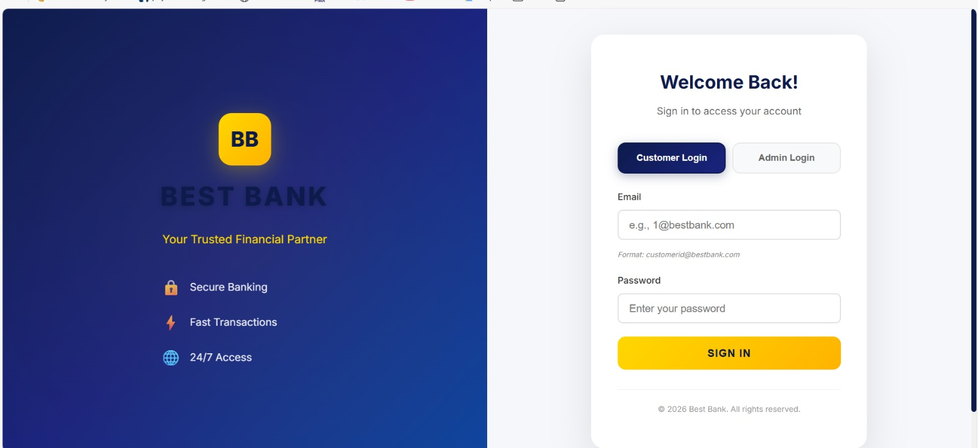
Banking Management System
Login Page:
2024 - RPS Consulting all rights reserved

Slide 13
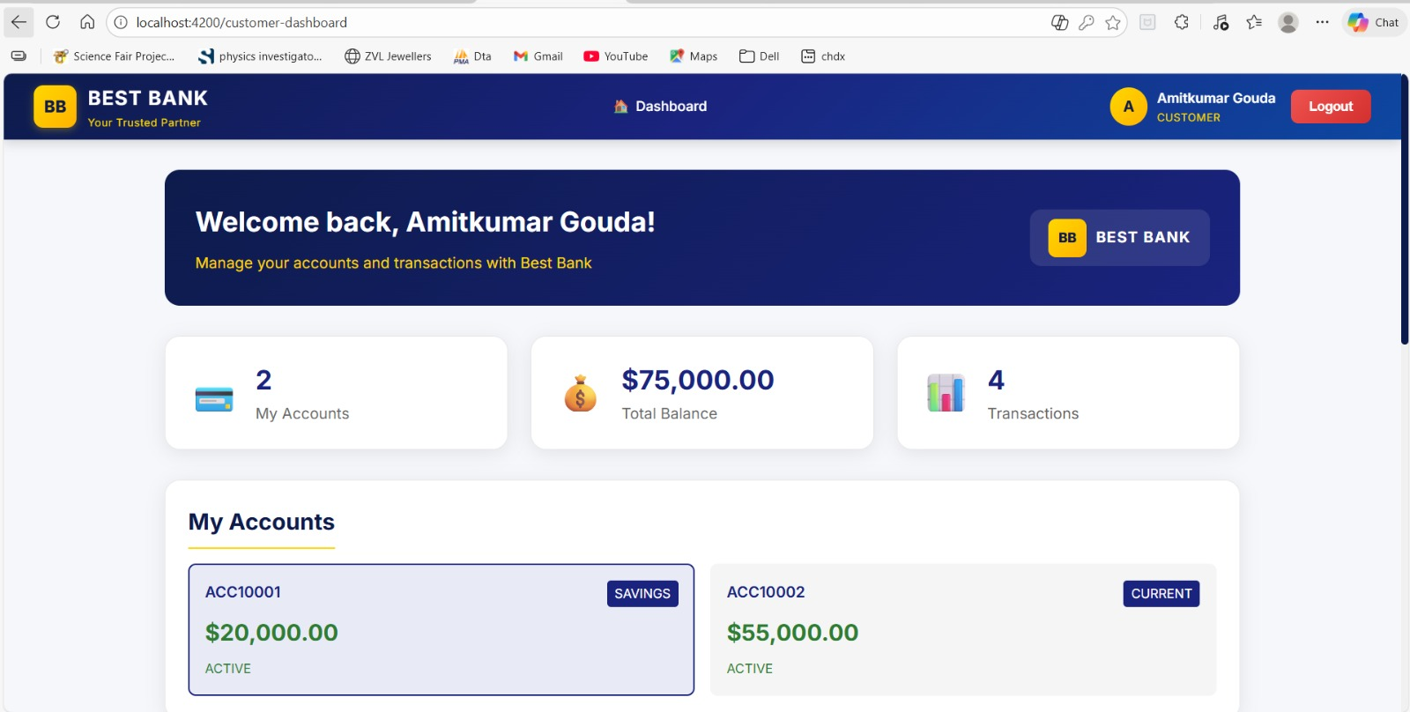
Banking Management System
Customer Page:
2024 - RPS Consulting all rights reserved

Slide 14
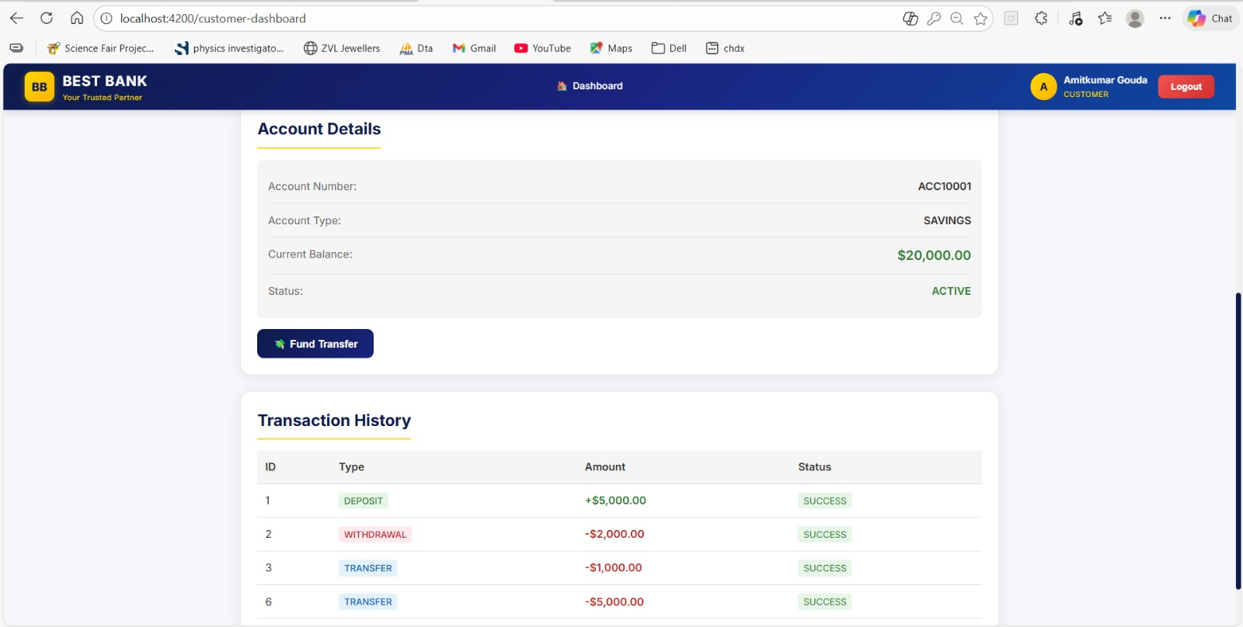
Banking Management System
Transaction Page:
2024 - RPS Consulting all rights reserved

Slide 15
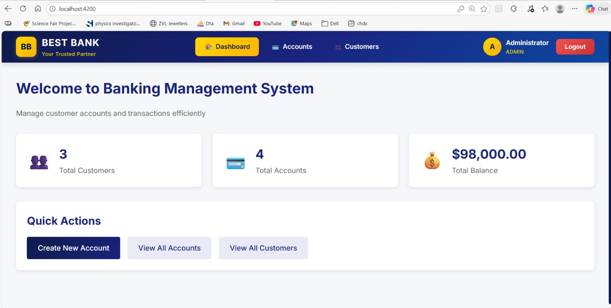
Banking Management System
Admin Page:
2024 - RPS Consulting all rights reserved

Slide 16
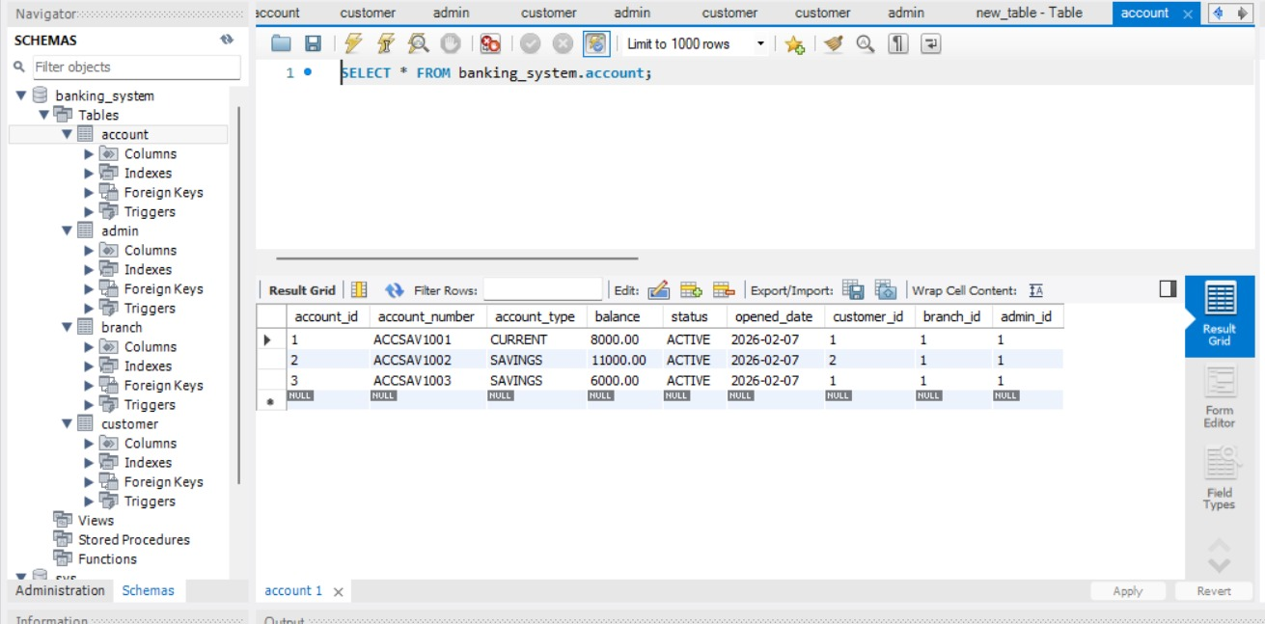
Banking Management System
Banking System Data in DB :
2024 - RPS Consulting all rights reserved

Slide 17
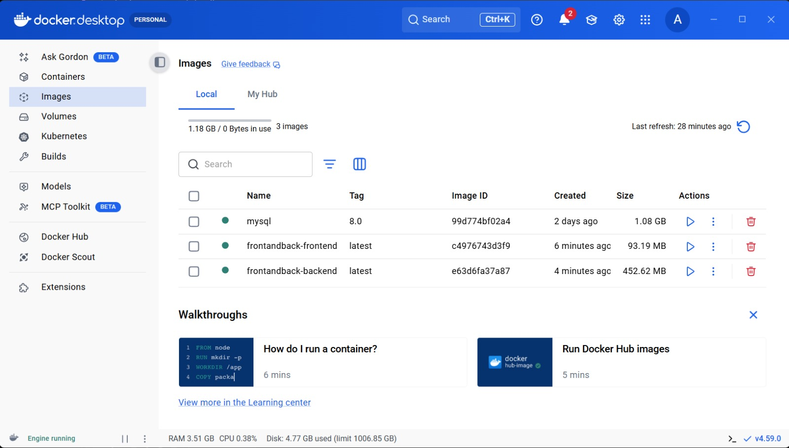
Banking Management System
Images created in Docker :
2024 - RPS Consulting all rights reserved

Slide 18
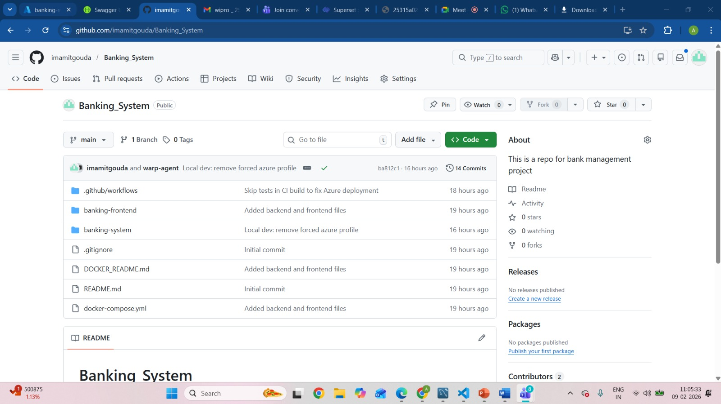
Banking Management System
GitHub Link: imamitgouda/Banking_System: This is a repo for bank management project

Slide 19
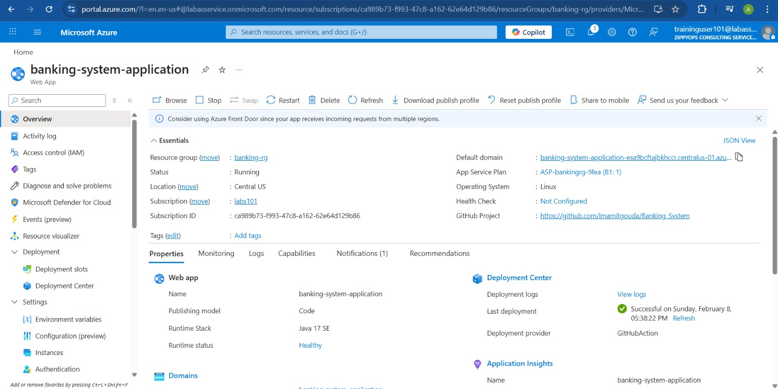
Banking Management System
Created App service in Azure:
2024 - RPS Consulting all rights reserved

Slide 20
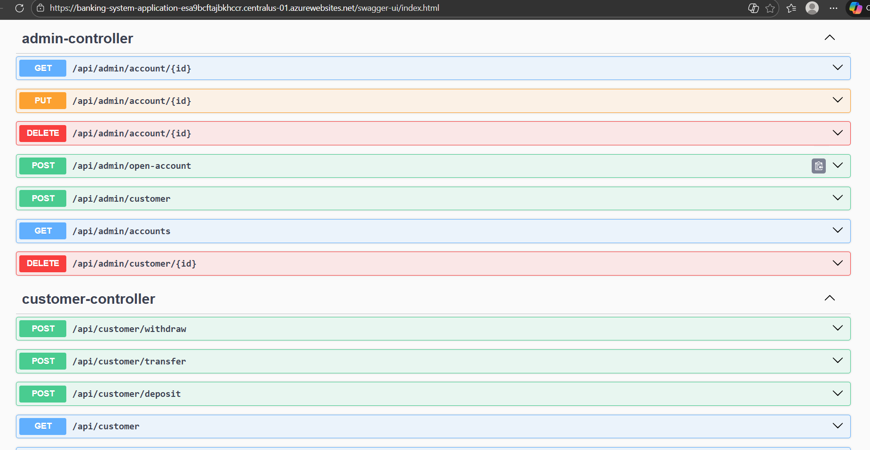
Banking Management System
Link : Swagger UI
2024 - RPS Consulting all rights reserved

Slide 21
Employee Management System
Conclusion:
The Banking Account Management System is designed to provide a simple and effective solution for managing banking activities in a digital environment. It helps in reducing manual effort and minimizing errors by automating account management and transaction processes. The system ensures secure storage of customer data and provides easy access to account details and transaction history.
With a user-friendly interface and structured workflow, the application improves the overall banking experience for both administrators and users. The project demonstrates how web-based technologies can be used to build reliable and scalable banking systems. In the future, the system can be enhanced by adding features such as fund transfers, online payments, and improved security mechanisms.
2024 - RPS Consulting all rights reserved

